Slide 1
Sales Performance Analysis Dashboard using Power Bi by TEAM 3 : Profit detectors

Slide 2
Team:
Shantanu Anand
Uday Kumar
Tanguturi Sai Kumar
Hindavi Patil

Slide 3
Project overview :
Purpose: To create an interactive Sales Performance Dashboard leveraging Power BI for actionable insights.
Key Features:
Integration of datasets: customer demographics, sales transactions, product data, and customer ratings.
Advanced analyses: customer lifetime value, churn prediction, product cannibalization, and customer sentiment.
Data visualization: Charts, maps, and analytics for better decision-making.
Outcome: A dynamic tool for understanding sales trends, customer behavior, and product performance.

Slide 4
Introduction :
The Sales Performance Dashboard leverages Power BI to turn complex sales data into actionable insights, providing a comprehensive view of sales and customer trends. This tool is tailored to help decision-makers understand key sales drivers and customer behaviors.
Dataset Overview:
The dataset integrates various data sources, including:
Customer Demographics: Information on customer regions, acquisition dates, and purchase frequency.
Sales Transactions: Detailed records of each sale, including order date, product sold, sale amount, and discount information.
Product Information: Data on product categories, pricing, release dates, and status (e.g., new vs. existing products).
Customer Feedback: Customer ratings and satisfaction metrics, allowing us to correlate sentiment with sales performance.

Slide 5
Module-1
Data Transformation

Slide 6
Transformations :
Made changes in the data type
Removed empty rows
Added new columns

Slide 7
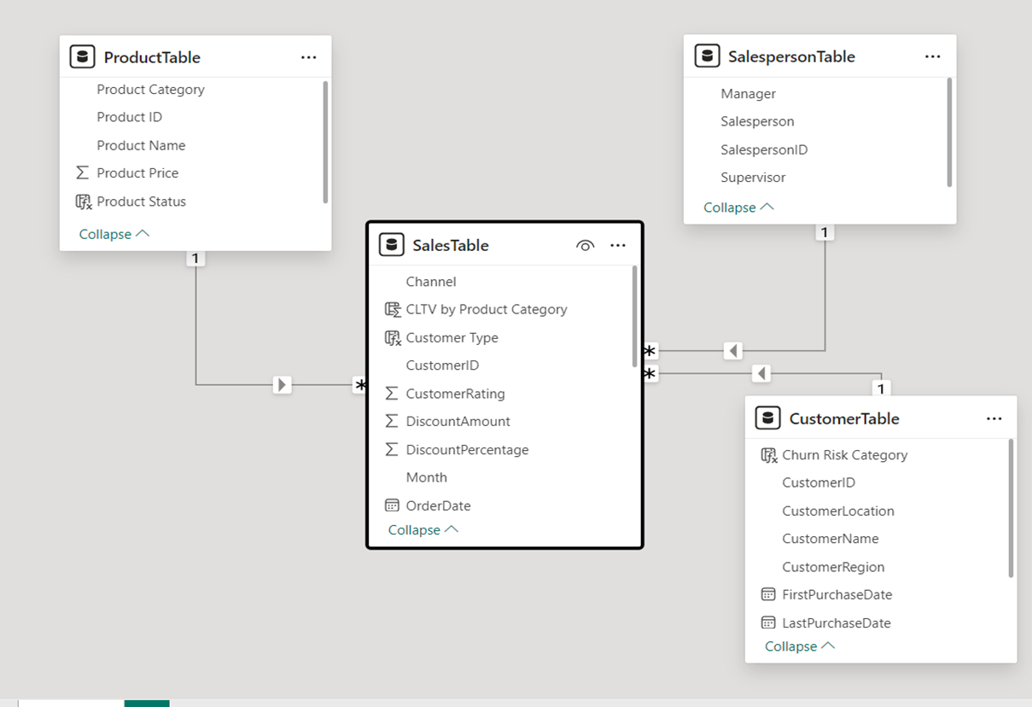
Dataset Model View

Slide 8
Module-2
Dax Formulae

Slide 9
DAX formulae :
Total Spend = SUM(SalesTable[Total_Amount])
Recency = DATEDIFF(MAX(CustomerTable[LastPurchaseDate]), TODAY(), DAY)
Customer Type = IF(
[Total Spend] > 8000000, "Platinum",
IF(
[Total Spend] > 4000000, "Gold",
"Silver"
)
)
Customer Count by Churn Category = CALCULATE(
DISTINCTCOUNT(CustomerTable[CustomerID]),
FILTER(
CustomerTable,
CustomerTable[Churn Risk Category] = SELECTEDVALUE(CustomerTable[Churn Risk Category])
)
)

Slide 10
DAX formulae :
Churn Risk Category = SWITCH(
TRUE(),
[Recency] > 980, "Inactive",
[Recency] > 750 && CustomerTable[PurchaseFrequency] <= 28, "At Risk",
[Recency] <= 750 && CustomerTable[PurchaseFrequency] > 28, "Retained",
TRUE(), "Potential"
)
Product Status = IF(DATEDIFF(ProductTable[ReleaseDate], TODAY(), YEAR) <= 2, "New", "Existing")
Average Sale Price = AVERAGE(SalesTable[SalePrice])
CLTV by Product Category = CALCULATE(
SUM(SalesTable[SaleAmount]),
ALLEXCEPT(ProductTable, ProductTable[Product Category])
)
Total Sales = SUM(SalesTable[SaleAmount])

Slide 11
DAX formulae :
Rating Category = IF(SalesTable[CustomerRating] == 5, "Excellent",
IF(SalesTable[CustomerRating] == 4, "Good",
IF(SalesTable[CustomerRating] == 3, "Average",
IF(SalesTable[CustomerRating] == 2, "Bad",
IF(SalesTable[CustomerRating]==1,"Worst")))))
Customer Status = VAR FirstPurchaseDate =
CALCULATE(
MIN(CustomerTable[FirstPurchaseDate]),
FILTER(
CustomerTable,
CustomerTable[CustomerID] = SalesTable[CustomerID]
)
)
RETURN
IF(
SalesTable[OrderDate] <= FirstPurchaseDate + 365,
"New",
"Repeat"
)

Slide 12
Module-3
Data Visualization

Slide 13
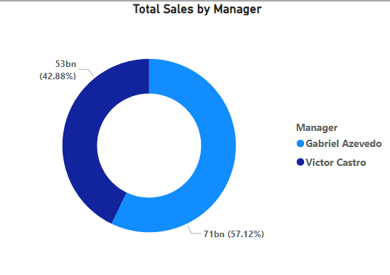
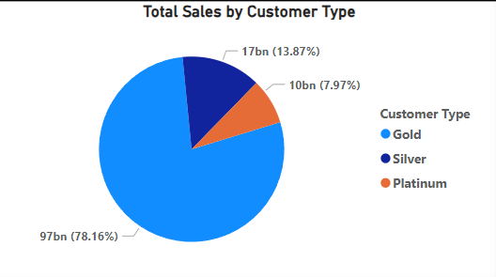
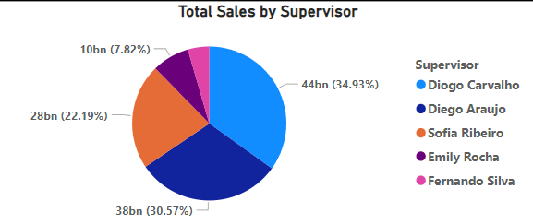
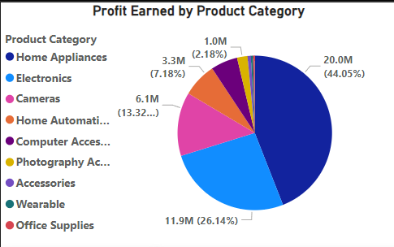
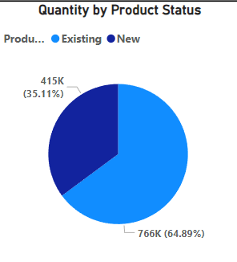
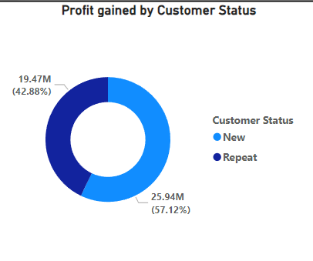
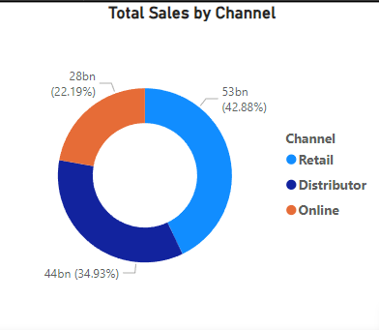
visualizations :
Pie and donut charts :

Slide 14
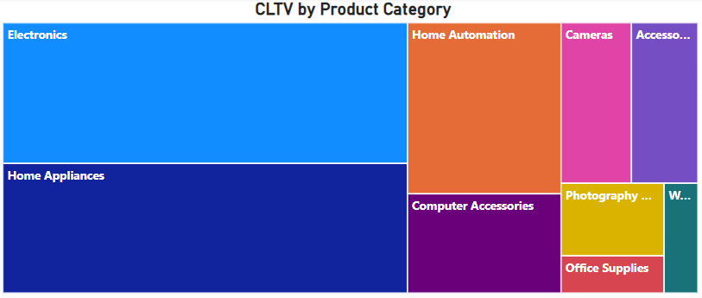
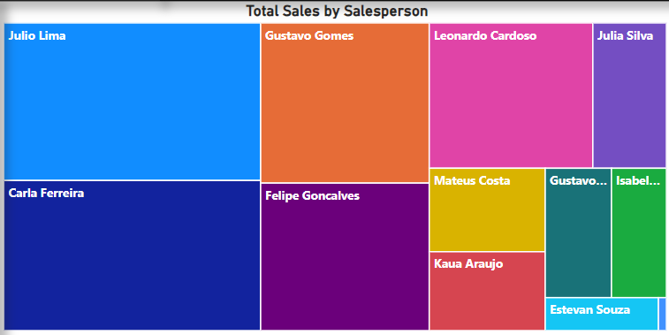
Tree map :

Slide 15
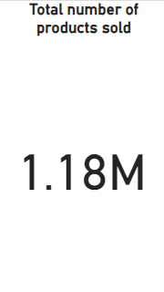
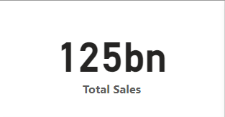
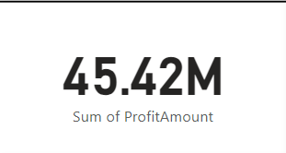

Cards :
Slicers :

Slide 16
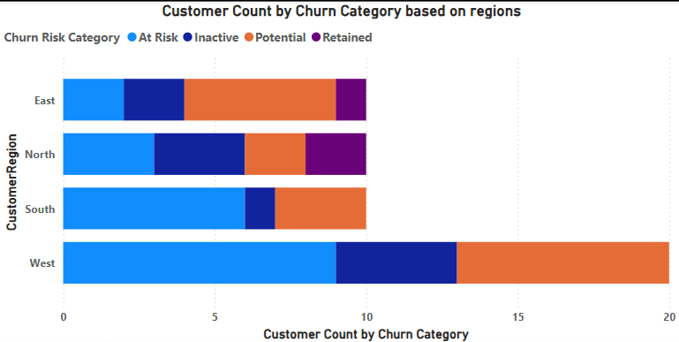
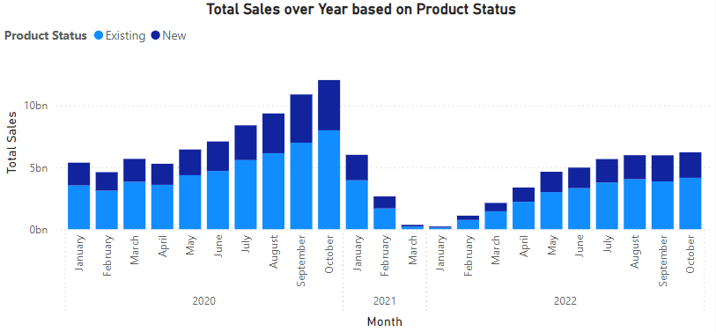
Stacked column and bar chart :

Slide 17
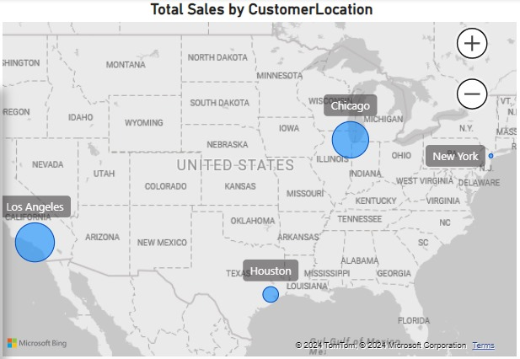
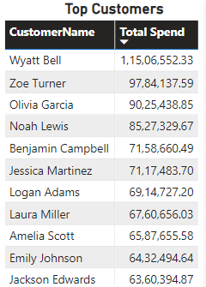
Map :
Table :

Slide 18
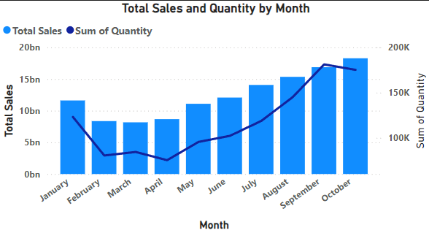
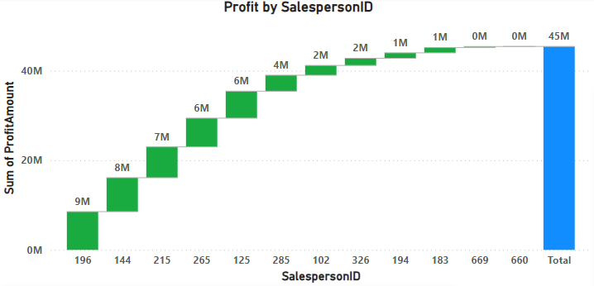
Line and column chart :
Waterfall chart :

Slide 19
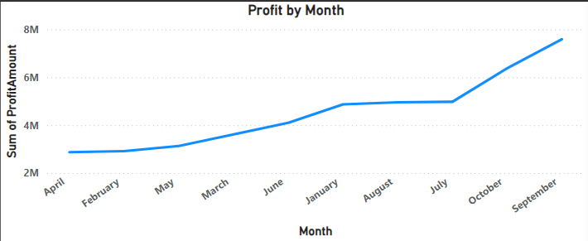
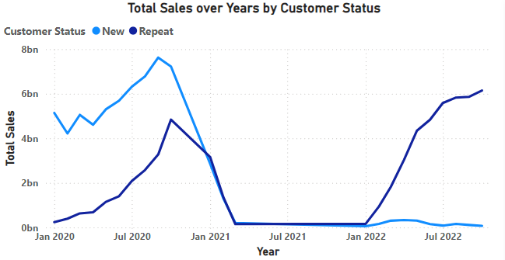
Line chart:

Slide 20
Module-4
Dashboard

Slide 21
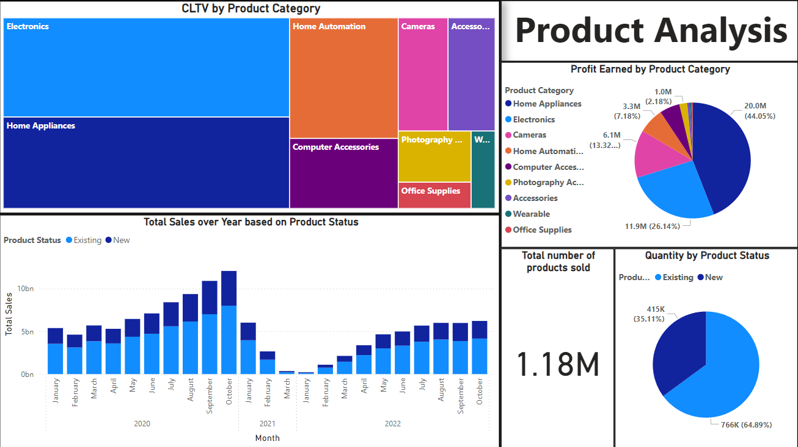

Slide 22
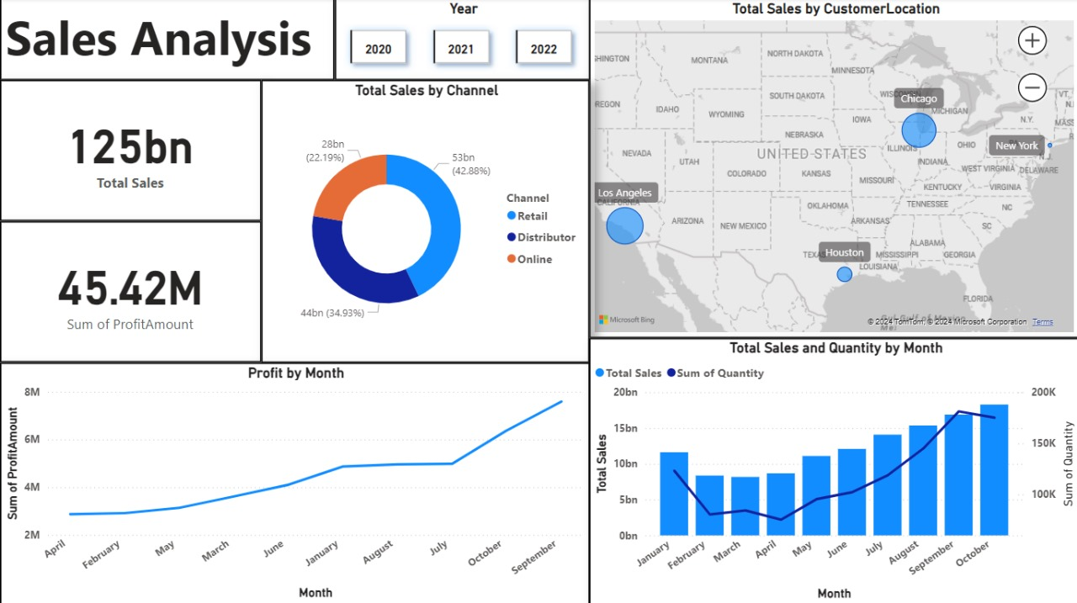

Slide 23
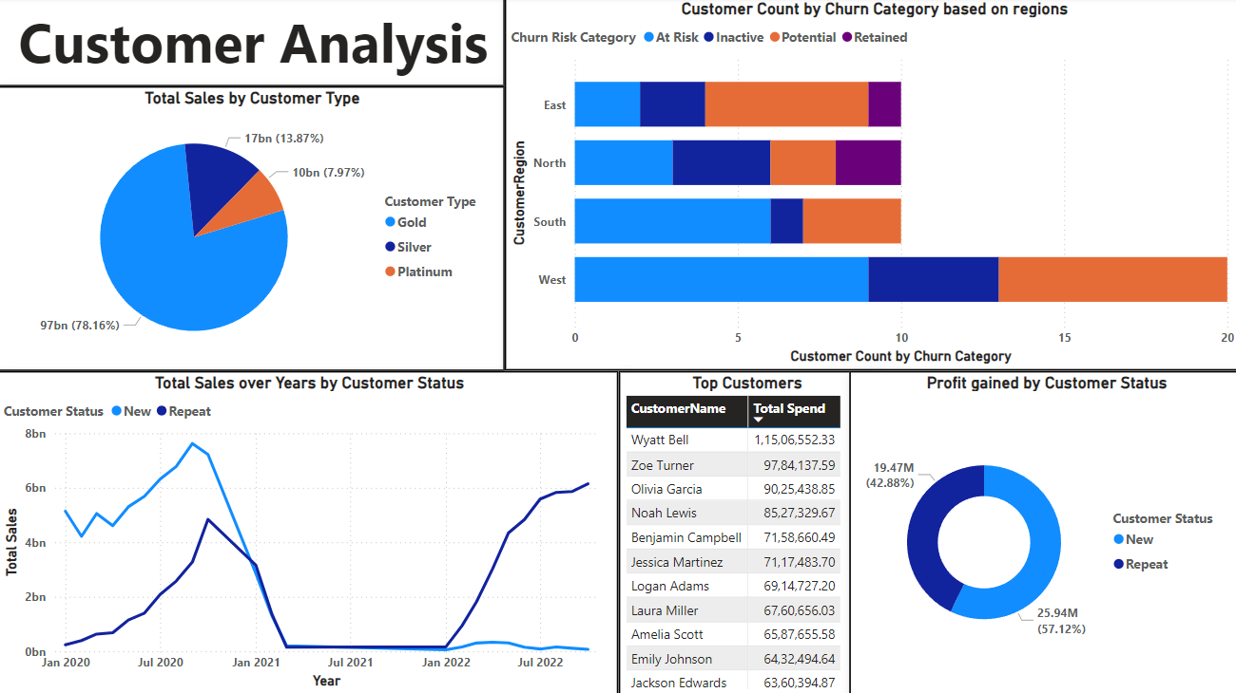

Slide 24
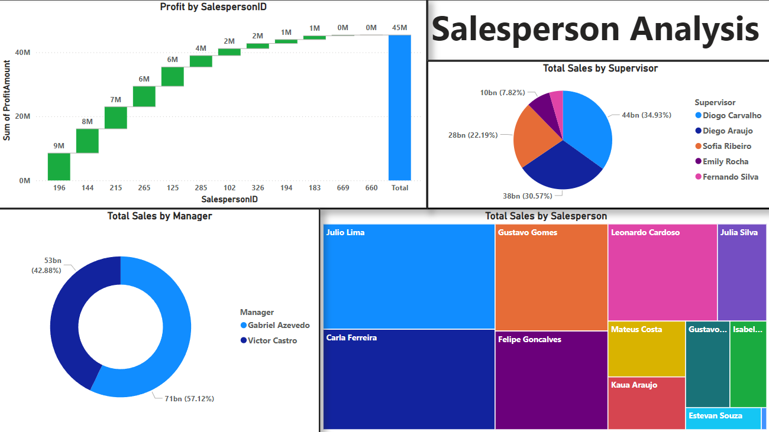

Slide 25
Conclusion :
The Sales Performance Dashboard offers a comprehensive view of sales dynamics, customer behaviours, and product trends.
Key analyses like CLTV, churn risk, and product sales cannibalization provide actionable insights for business growth and customer retention.
Advanced visualizations, such as ribbon charts, pie charts, and geo-mapping, ensure data is interpretable and actionable.
Real-time decision-making is supported, enabling businesses to adapt to challenges and opportunities.
A modular design ensures future scalability, aligning with evolving business needs.

Slide 26
FUTURE ENHANCEMENTS:
Advanced Segmentation: Categorize customers by behaviour and demographics for personalized marketing.
Predictive Analytics: Employ machine learning for sales forecasting and inventory optimization.
Marketing Impact Analysis: Assess campaign effectiveness on customer acquisition and retention.
Enhanced Geo-Spatial Insights: Use advanced maps to identify local trends and adjust strategies.
Product Velocity Analysis: Measure product demand trends to optimize production.
Discount Effectiveness Analysis: Evaluate promotion impacts to maximize revenue.
Sentiment Tracking: Integrate customer feedback for better product development

Slide 27
Thank you
Team profit detectors

